Slide 1

Materials

Slide 2
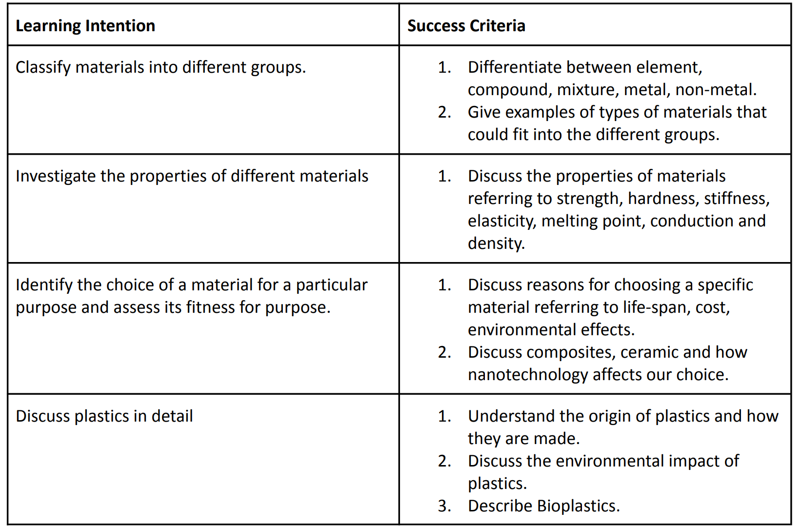
What you need to know

Slide 3

1. Classify different materials - differentiate between element, compound, mixture, metal, non-metal.
2. Give examples of types of materials that could fit into the different groups.

Slide 4
What is a material?
Notes:
https://www.twinkl.ie/teaching-wiki/material#:~:text=A%20material%20is%20any%20substance,is%20made%20up%20of%20materials.

Slide 5
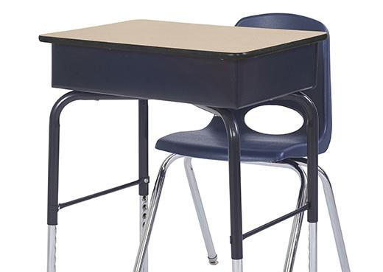
Material
Is a substance that things are made from
Notes:
The substance used to make something is called a material
A school desk, for example, may be made from wood, plastic, or metal—or a mixture of all three materials.
When an object is designed and made, it is important to choose the best material for the job. Materials have certain qualities, or properties, such as strength, color, and hardness, that have to be considered carefully.
Glass, chalk, paper, wax, water, air, clay and plastic are all different materials. All materials are made up of matter. Almost everything we know of is made up of materials.

Slide 6

Design an object
Important to choose from the best materials to suit this object.
Consider:
Purpose of the object
Strength
Colour
Hardness etc.

Slide 7
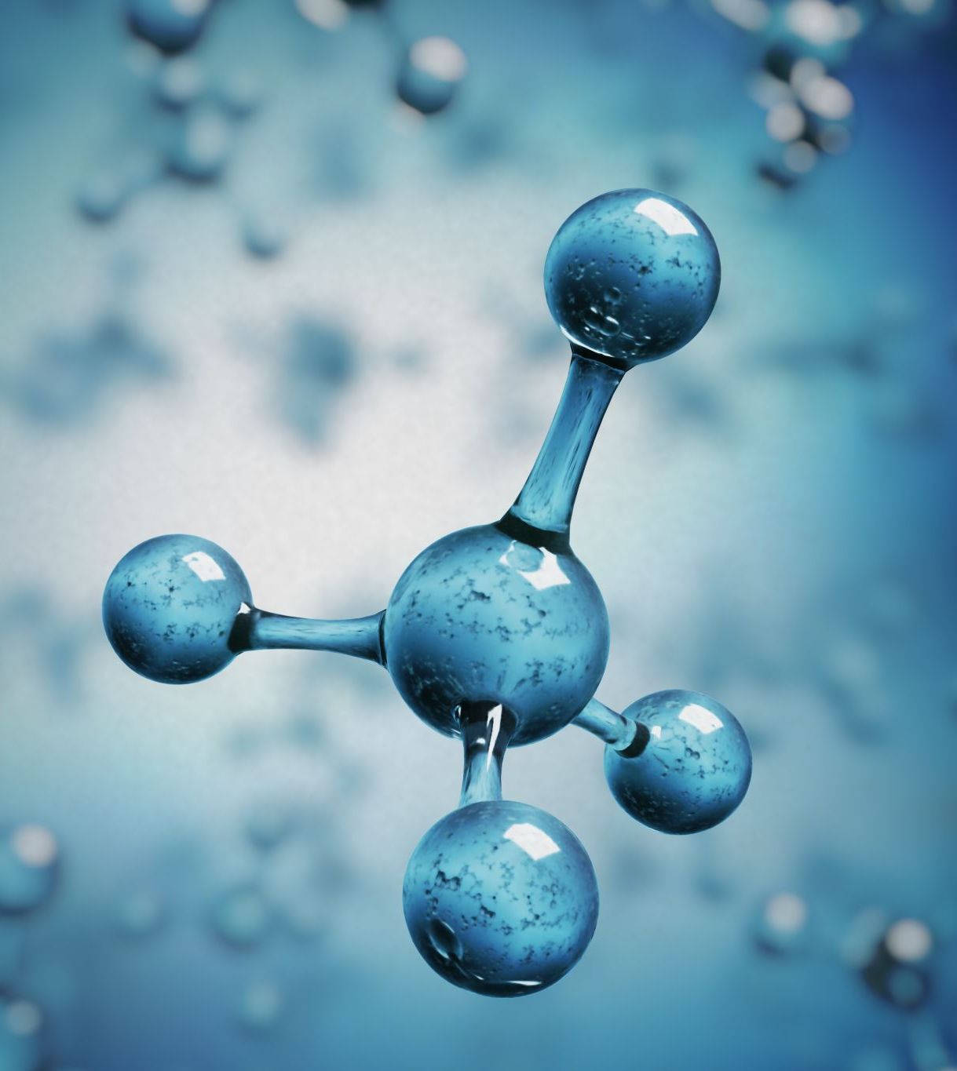
Classifying materials
Materials can be grouped based on their properties:
Solids, liquids & gas
Metals & non metals
Element, compound & mixtures
Natural & synthetic (manufactured)
Notes:
Properties are the characteristics that enable us to differentiate one material from another

Slide 8
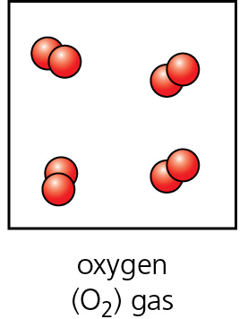
Element
An element is a substance that cannot be split up into similar substances by chemical means.
Element contains only one type of atom.
Elements are building blocks of all matter in the world.
Eg . Oxygen, Helium
Notes:
We learned about particle theory – learned about how particles are arranged these particles can be referred as atoms (look at that again)
In 1600s a scientist intro the world elemnt meaning cannot be broken doen into similar pieces
Elements are the simplest chemical substances that cannot be broken into any further simpler form by any chemical reaction. There are about 118 known elements in the periodic table.
An element is a pure substance that is made from a single type of atom. Elements are the building blocks for all the rest of the matter in the world. Examples of elements include iron, oxygen, hydrogen, gold, and helium.
Aluminum is used in making airplanes, buildings, pots, pans, etc.
Copper is used in wires, coins, and cooking utensils
All matter on earth is made from elements or combinations of elements

Slide 9
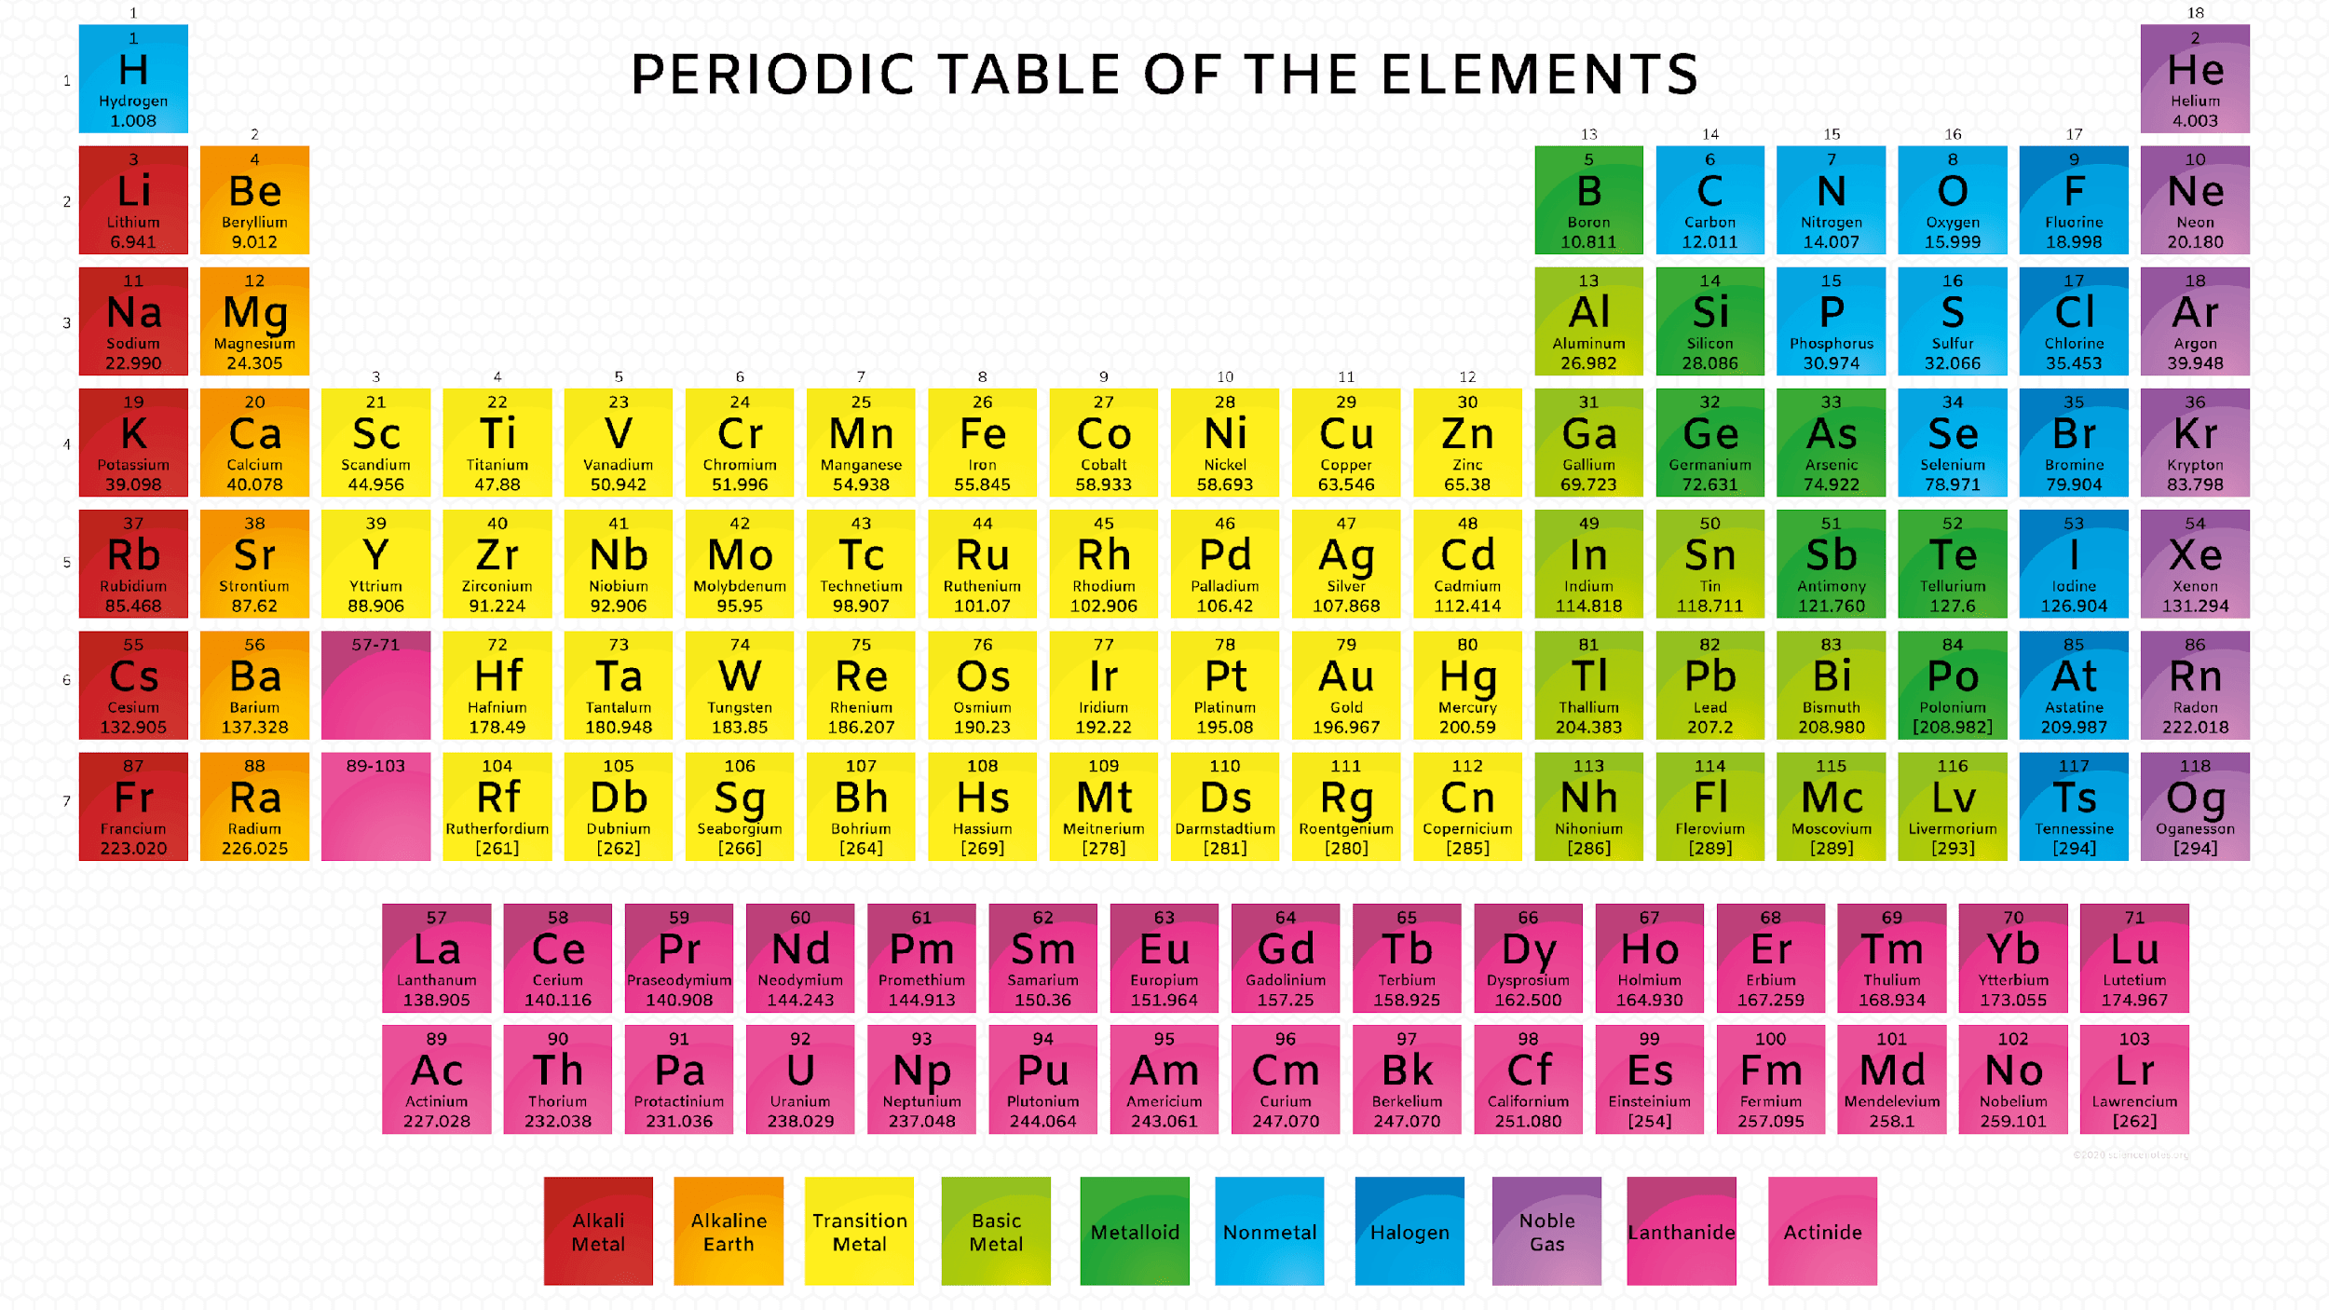
Notes:
If a substance is not on the periodic table then it is not an element it is a compound E.g. Water

Slide 10
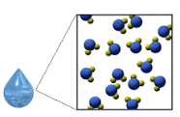
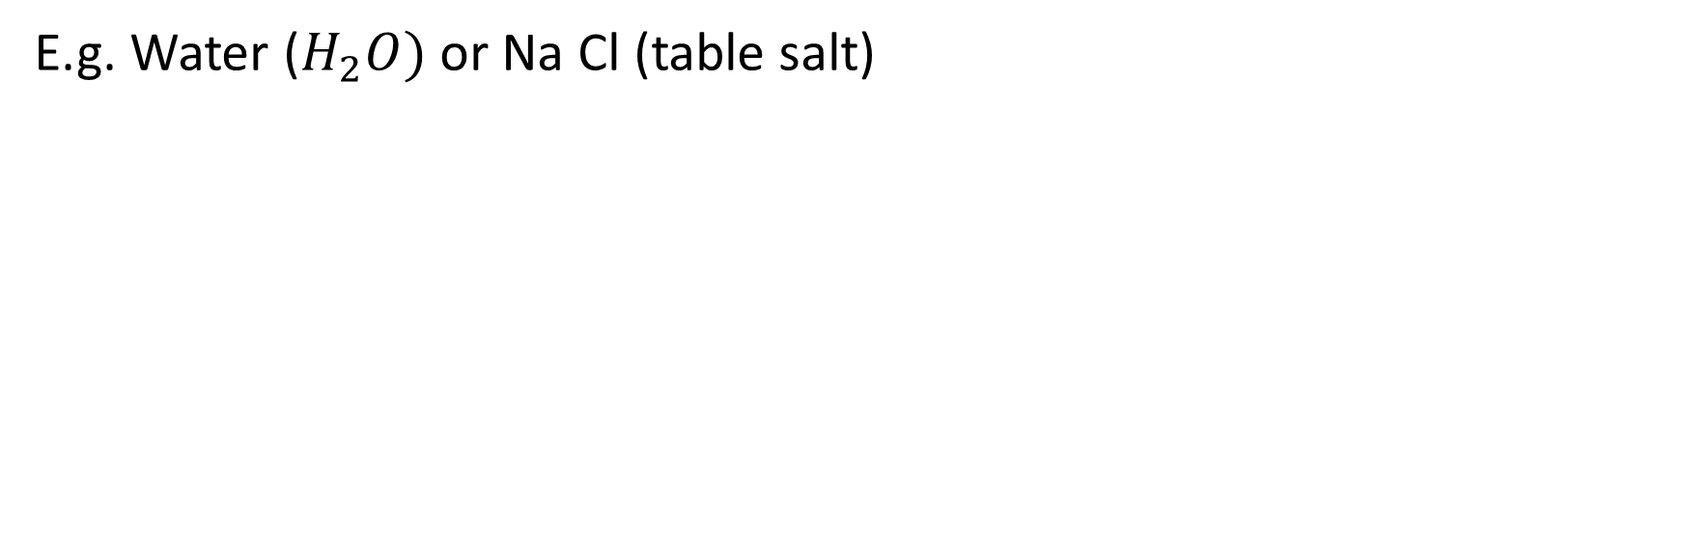
Compound
Is a substance that is made up of two or more different elements that are chemically combined (joined together).
Notes:
Table salt Na Cl
CO2

Slide 11
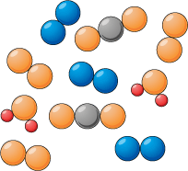
Mixture
A mixture consists of two or more different substances mingled together but not chemically combined.
E.g. Air is a mixture of oxygen, nitrogen and carbon dioxide.
Notes:
Concrete is a mixture of sand, cement, water and other substances.
Seawater

Slide 12
State the differences between a mixture and a compound

Slide 13
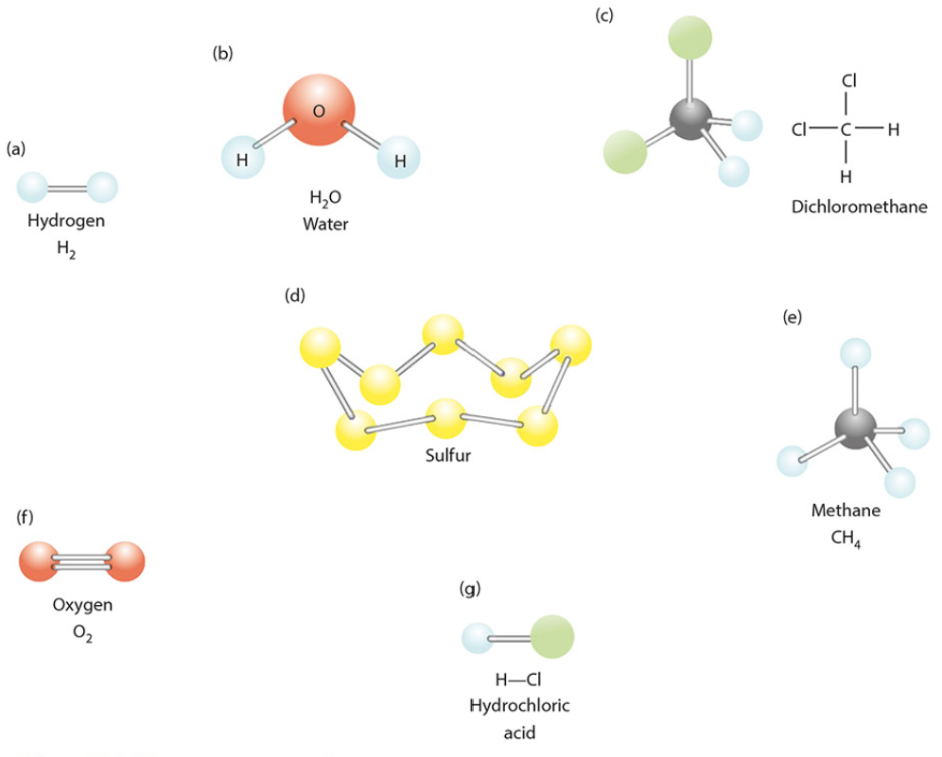
Look at the structures and state whether each one is a compound or mixture

Slide 14

Can a mixture be separated ?
Name a separation technique that you might use

Slide 15
Complete this table using your everyday knowledge
Material | Element/ Compound/ mixture | Metal / non metal | Natural / syntenic
Plastic
Water
Coal
Glass
Helium
Iron
Wood

Slide 16
Fill in the blanks
An atom is the smallest part of an __________.
An element contains _____________________________.
Compounds are formed from elements by ____________________.
Water is a __________ formed by chemical reaction of elements oxygen and hydrogen
One type of atom only Element
Chemical reaction Compound

Slide 17
Think of any material and write down its properties
Notes:
Physical and chemical characteristics

Slide 18
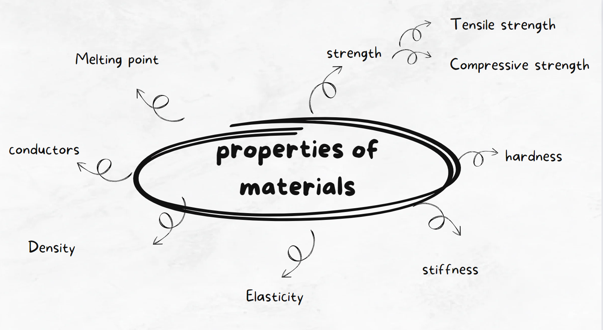

Slide 19
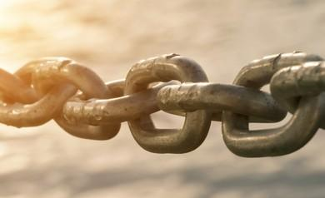
Strength
Strength is how good a material is at resisting a force.
Two types of strength:
Tensile strength
Compressive strength

Slide 20
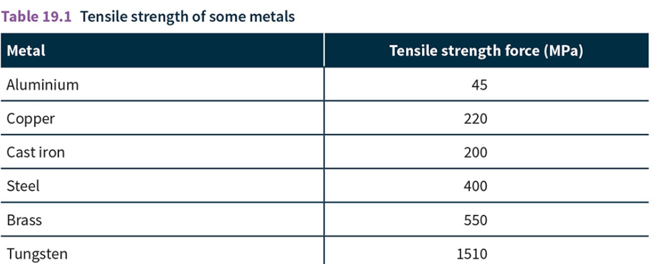
Tensile strength
Is how much a material can resist a pulling force
What metals do you think are not used to make cables in the construction of bridges?

Slide 21

Compressive strength
How well a material can resist pushing force
Notes:
Bricks need a good compressive strength or they could be squashed by weight of the bricks above them

Slide 22
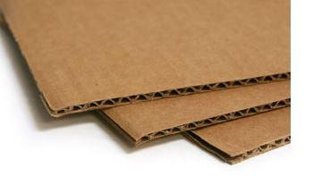
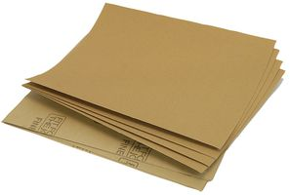
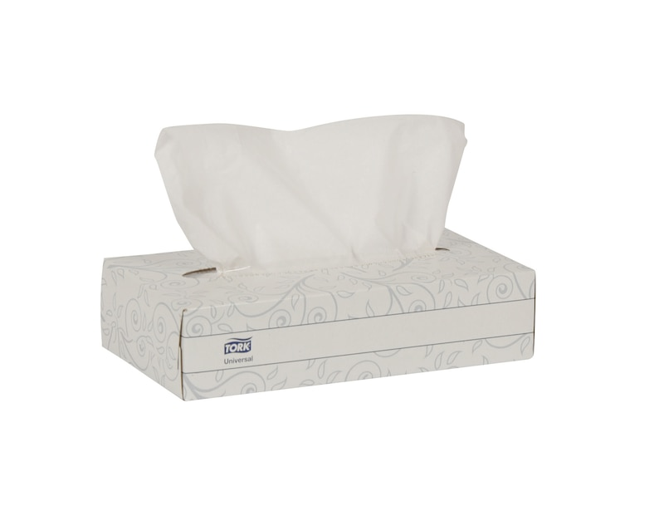

List all the different types of paper. Put them in order of how strong you think they are.
Notes:
Sand paper Cardboard card newpaper tissue paper

Slide 23
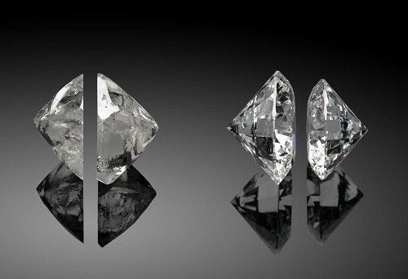
Hardness
The hardness of a material is how difficult it is to cut into it.
Notes:
Solids can be hard because their particles are held so close together by strong bonds
Hardest material found in nature is dimond

Slide 24
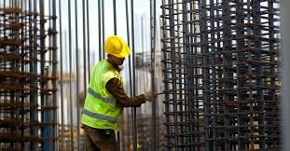
Stiffness
A stiff material does not bend or change shape when a force is applied.
Steel bars are used in construction as they are very stiff in which they support large structures.

Slide 25

Elasticity
Is how much a solid can be stretched and return to its original shape and size
Notes:
Solids are elastic because their particles are held together with stretchy bonds, so when you pull the material the bonds will stretch but can then spring the particles back to their original position.

Slide 26
Make a sketch of how the particles are arranged in an upstretched band

Slide 27
Density
How much matter (mass) there is in a certain volume.
Solids can be very dense because their particles are packed closely together.
Some solids have a low density such as aluminium which can be used to make an aircraft.

Slide 28
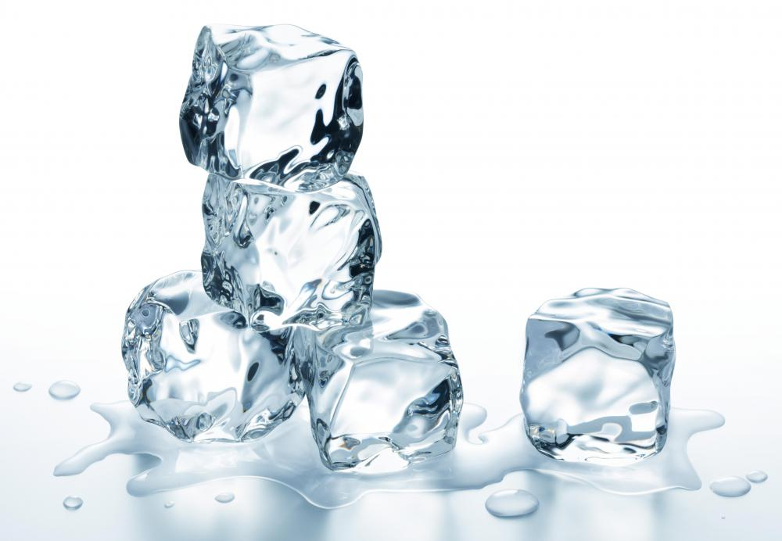
Melting point
The temperature at which solid material turns into a liquid

Slide 29


Conductors
A conductor is a substance that allows something to pass through it easily. E.g. heat or electricity.
Metals are excellent conductors
Nonmetals are poor conductors.

Slide 30
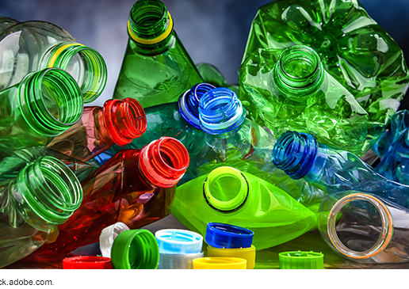
Plastics
Notes:
https://padlet.com/eforan4/outline-the-environmental-disadvantages-of-plastics-nqi3064qj7hymnqd

Slide 31
Questions to answer
What are plastics made from ?
What is the negative effect of producing plastics ?
Where are plastics exported to?
What % of plastics end up in the environment ?
What % of plastics are recycled ?

Slide 32

Notes:
https://www.youtube.com/watch?v=iO3SA4YyEYU

Slide 33
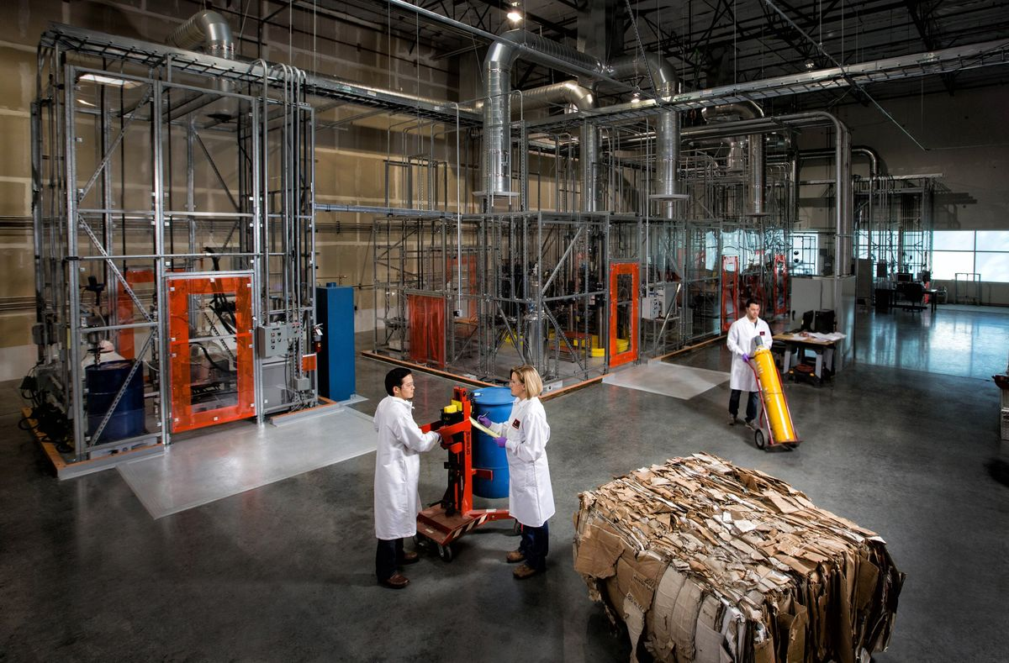
Origin of plastics
Most plastics are made from chemicals that come crude oil.
Notes:
Molecules are groups of two or more atoms, which are the tiny building blocks of everything.)

Slide 34
Name some properties of plastic
Notes:
Molecules are groups of two or more atoms, which are the tiny building blocks of everything.)

Slide 35
Plastic properties
hard, strong and stiff.
low density
mouldable
Notes:
Low density - so they are good for lightweight goods.

Slide 36
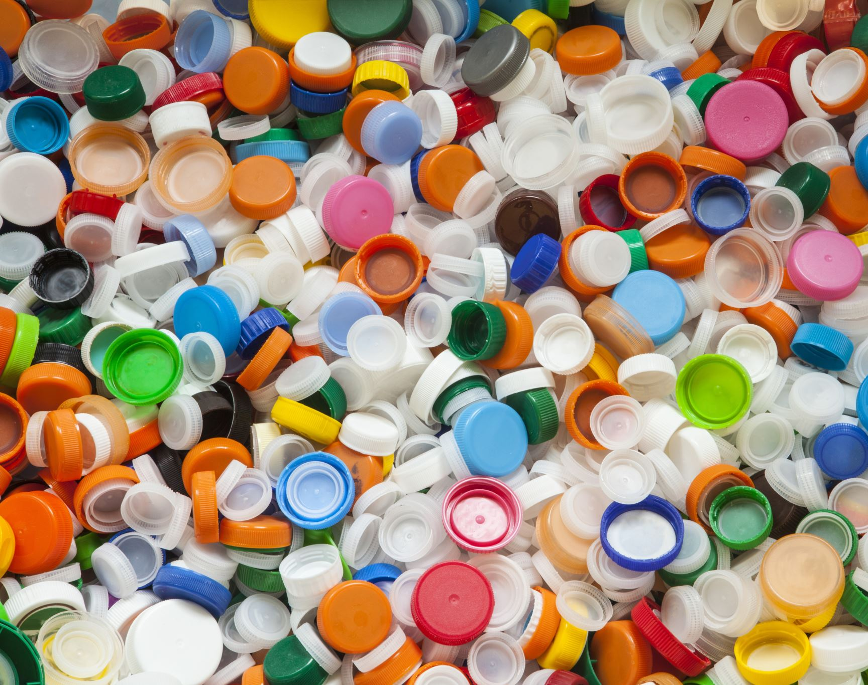
What are the environmental impacts of plastics ?
Plastics are not biodegradable (do not break down by bacteria or fungi).

Slide 37
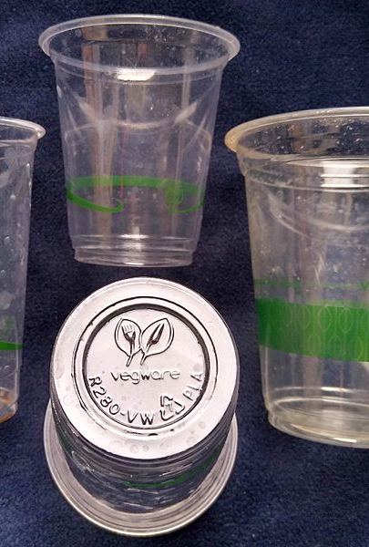
Bioplastics
Bioplastics are biodegradable plastics made from renewable biological sources.
Can be decomposed by the action of living organisms, usually microbes, into water, carbon dioxide, and biomass.
Polylactide is made from sugarcane.

Slide 38
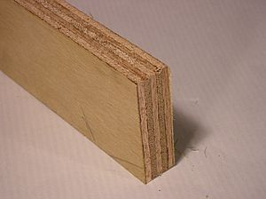
What are composites
A compost material is made up of at least two other materials
These materials must be layered or woven together.
E.g. Plywood is made up of three or more thin layers of wood bonded with adhesive, cement or concrete.

Slide 39
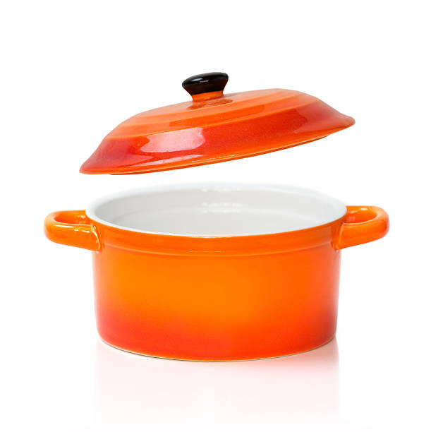
Ceramics
Ceramics is a non metallic synthetic mixture
Ceramics are usually:
Cheap
Hard
Resistant to high temperatures
Long lasting
Low density compared to metals
Poor conductors of electricity

Slide 40
How do we choose a material
What materials are you going to use?
Will the material last?
How will the material look?
Will the material be easy to process and use?
What are the costs?
What effect will this material have on the environment?

